Slide 1

BRIEFMEET
Melanie Yu
Max Banister
Arvind Sridhar
Brandon Soeung
Class of 2020
Class of 2021
Class of 2021
Class of 2019

Slide 2

AGENDA
The Team
Problem
Solution
Product
Usage
Q&A

Slide 3

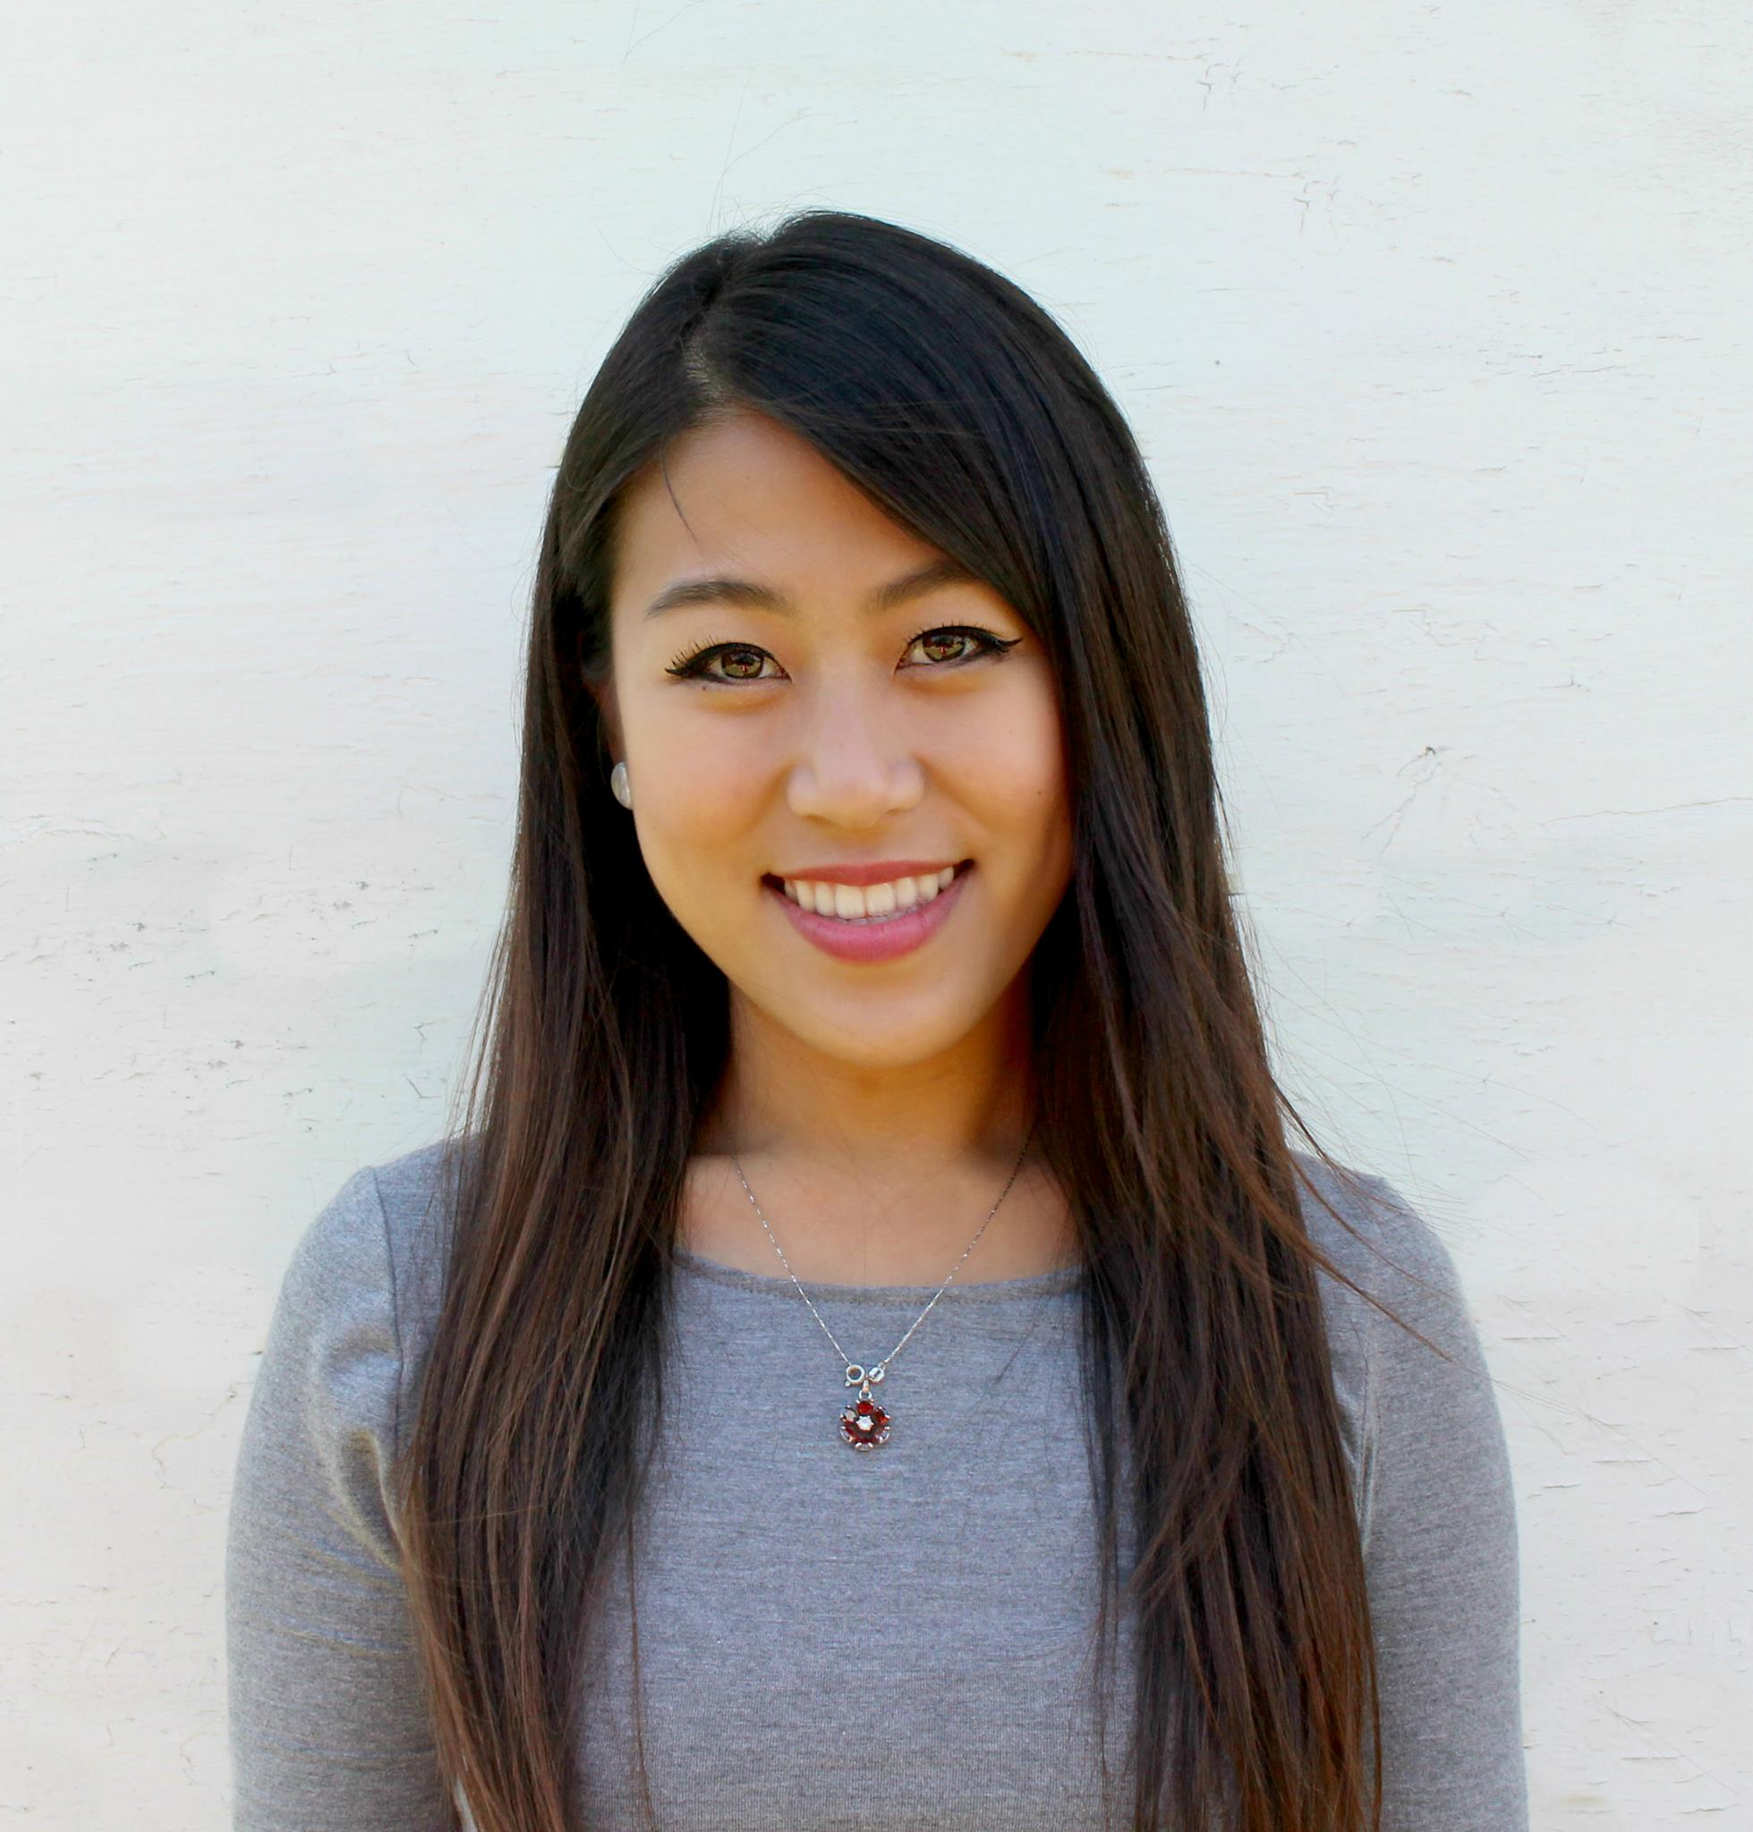
THE TEAM
Meet Brandon, Max, Mel, and Arvind!
Brandon
Soeung
Max
Banister
Melanie
Yu
Arvind
Sridhar
INTRODUCTION
PRODUCT
USAGE

Slide 4
PROBLEM
Networking events lack a proper way to track all the people you meet
We all meet dozens of people at large networking events
(i.e. Cal Hacks)
but can’t remember their names - or faces!
INTRODUCTION
PRODUCT
USAGE

Slide 5
PROBLEM
Making a good impression is important and inevitable
INTRODUCTION
PRODUCT
USAGE

Slide 6
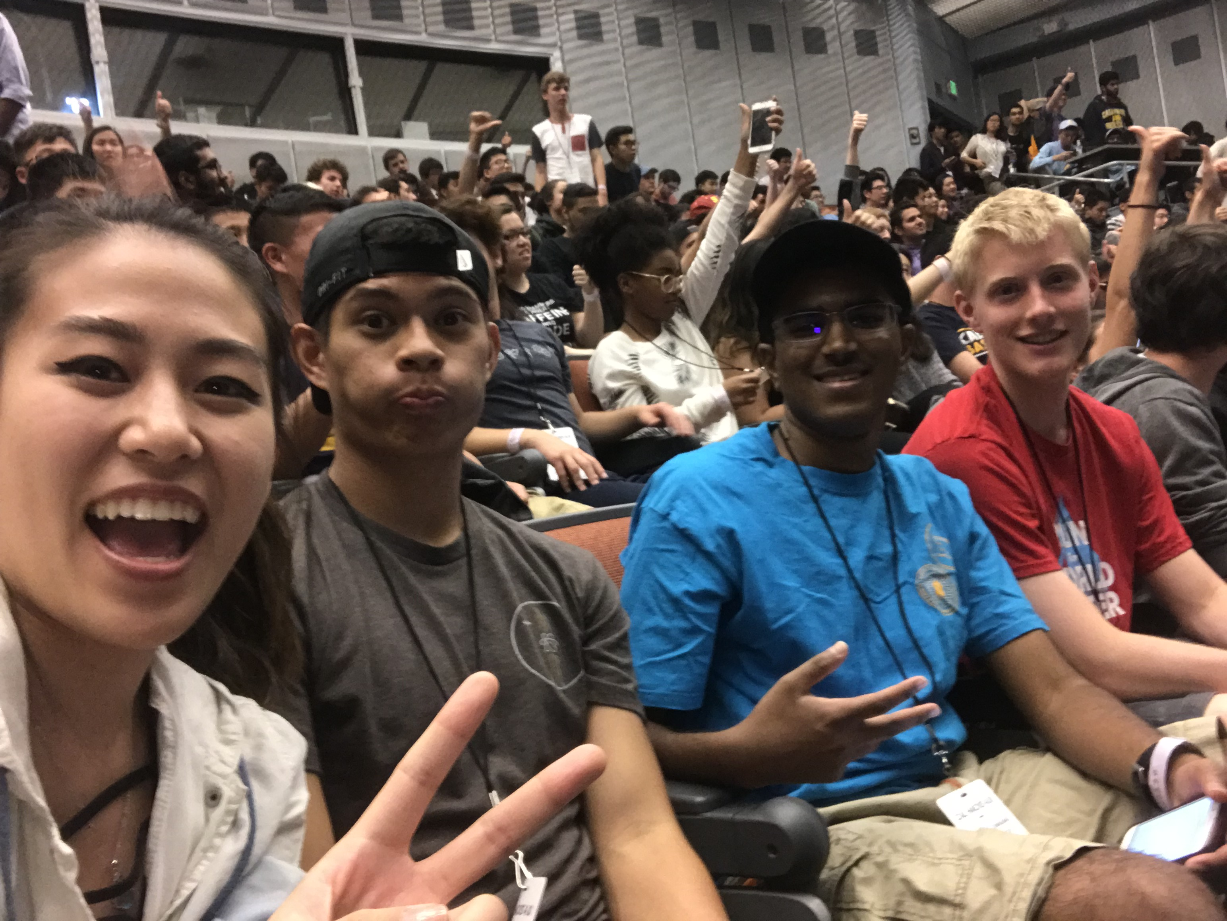
SOLUTION
We can solve this with photos – selfies!
Take photos with the people you meet
BRIEFMEET:
A SHORT ENCOUNTER
Take down notes, and their names
Mel, Brandon,
Arvind, Max
Remember and connect with them after
INTRODUCTION
PRODUCT
USAGE

Slide 7
PRODUCT
BriefMeet – allows people to meet and remember each other
INTRODUCTION
PRODUCT
USAGE

Slide 8
USAGE
Networking events lack a proper way to track all the people you meet
INTRODUCTION
PRODUCT
USAGE

Slide 9
USAGE
Networking events lack a proper way to track all the people you meet
INTRODUCTION
PRODUCT
USAGE

Slide 10
QUESTIONS
ANSWERS

